Slide 1
Statistical Data Mining – I New York Stock Exchange
ANCHAL SOJATIYA
KAVYA ANANTHA RAO SAMRATSINH DHUMAL

Slide 2
AGENDA
Motivation and Objective
Goals
Dataset Description
Exploratory Data Analysis
Holt-Winters method for Time Series
Z-Score Calculations

Slide 3
MOTIVATION AND OBJECTIVE
As the variation in the IT market is on a rise, we have focused on the data in the ‘Information Technology’ sector, to predict how a company might perform in the near future and determine the companies that might get bankrupt
The analysis of the same is a sought field in finance, which could be used to protect a company by tracking its performance or to advise investors, share holders and stock market specialists to make decisions
These might help to foresee any challenges pertaining to recession and help take measures to avoid it

Slide 4
GOALS
Check for the completeness of the data and use appropriate data cleansing method
Investigate data in the Information Technology sector using EDA and explore the trends of company’s stocks over a period to analyze the performance
Predict the future stock prices using Holt-Winters for time series data
Determine the companies that might get bankrupt in the near future

Slide 5
DATASET DESCRIPTION
Includes data from 2010 to 2016, for 508 companies, and has 4 files
Prices.csv: raw data with daily stock prices, mostly from 2010 to 2016. For companies that are new in stock market, the date range is shorter
Prices-split-adjusted.csv: same as prices, with additional adjustments for splits
Securities.csv: details of companies with respect to sectors, regions and start date
Fundamentals.csv: metrics data from annual SEC 10K fillings with 78 predictors

Slide 6
EXPLORATORY DATA ANALYSIS
Data was loaded from CSV
Column names were modified
Checked for NA values and eliminated them where appropriate
Filtered the dataset to include data from Information Technology sector
Merged the data from fundamentals and securities tables by ‘index’

Slide 7
TREND OF BIG FIVE STOCKS
Considered big five stocks namely – Google, Apple, FB, Microsoft, Intel Corporation
Used the ‘closing price’ data to study the trend over the past years

Slide 8
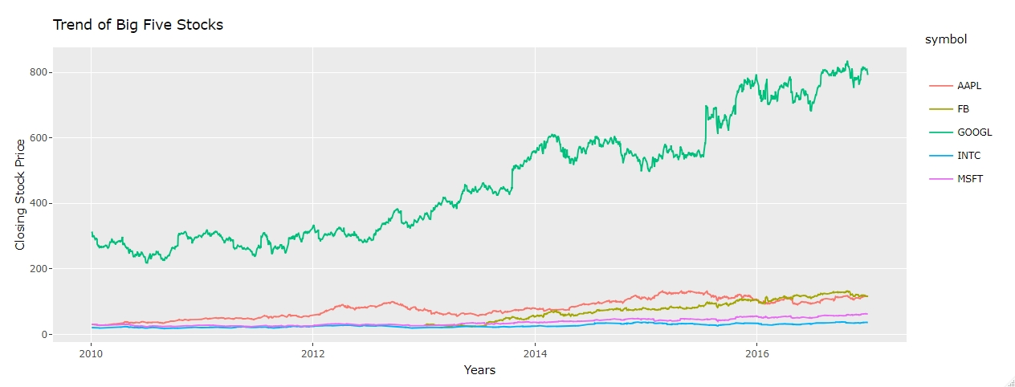

Slide 9
HOLT-WINTERS METHOD
Model of time series behavior allows to forecast
Allows to model three aspects of the time series: a typical value (average), a slope (trend) over time, and a cyclical repeating pattern (seasonality)
Triple exponential smoothening to encode values from past and use them to predict values for present and future

Slide 10
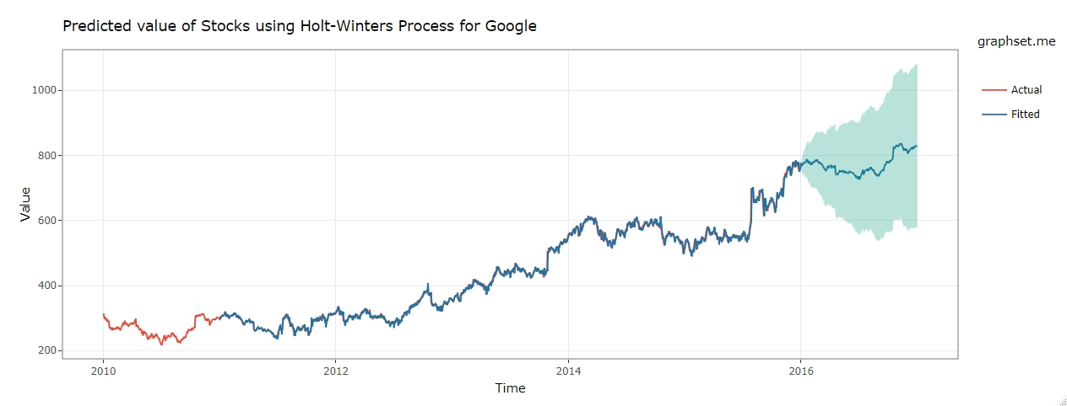

Slide 11
THE Z-SCORE VALUE
The Altman Z-Score is used to predict the likelihood that a business will go bankrupt within the next two years
The formula is based on information found in the income/balance sheet of an organization
It is given by:
Z = 1.2*A + 1.4*B + 3.3*C +0.6*D + 1*E
where,
A = working capital / total assets
B = retained earnings / total assets
C = earnings before interest and tax / total assets
D = market value of equity / book value of equity
E = sales / total assets

Slide 12
DISTRIBUTION OF Z-SCORES
Z-score range | Zone of discrimination | Distress level
Negative | Distress zones | Severely distressed
Between 0 and 0.99 |  | Moderately distressed
Between 1.00 and 1.81 |  | Mildly distressed
Between 1.81 and 2.40 | Gray zones | Slightly distressed
Between 2.41 and 2.99 |  | Stable, but weak
Between 3 and 4.99 | Safe zones | Strong
Between 5 and 7.99 |  | Highly strong
Greater than 8 |  | Almost no distress

Slide 13
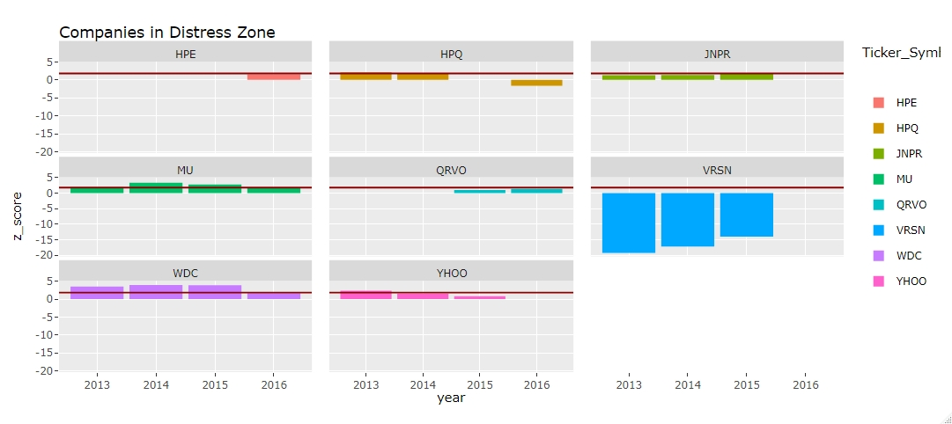

Slide 14
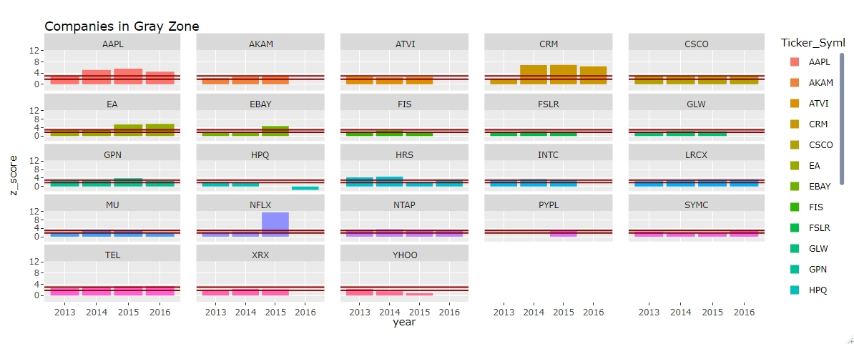

Slide 15
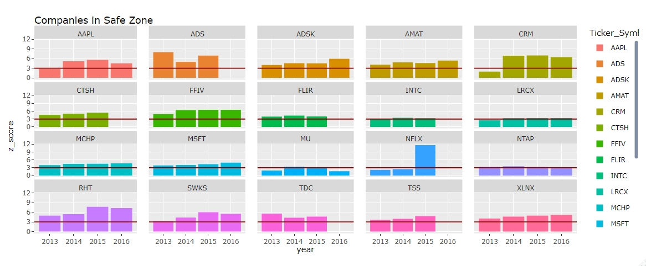

Slide 16
THANK YOU

